Slide 1
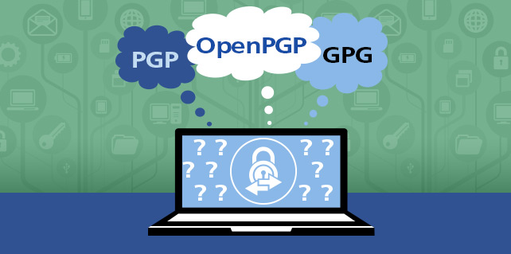
OpenPGP Email Encryption Workshop
by Alex Chesnakov

Slide 2

About me
Alex Chesnakov
Senior Engineer, Security Manager @ Health Gorilla
Security
Linux, AWS, CTFs
You may see me sailing or flying kites at Shoreline Lake
All opinions are my own and not those of my employer.

Slide 3
Goals
Introduction to OpenPGP encryption
Create OpenPGP keys
Setup OpenPGP encryption in Thunderbird email client
Exchange encrypted email messages with 2-3 recipients
Encrypt, Decrypt, Sign and check Digital Signatures

Slide 4
Encryption
Encryption Algorithms:
Symmetric (AES256, encrypted zip file)
Asymmetric (OpenPGP)
Usage:
In transit (https://, WIFI encryption)
At Rest (Mac and Windows disk encryption)
End-to-End Encryption (OpenPGP)

Slide 5
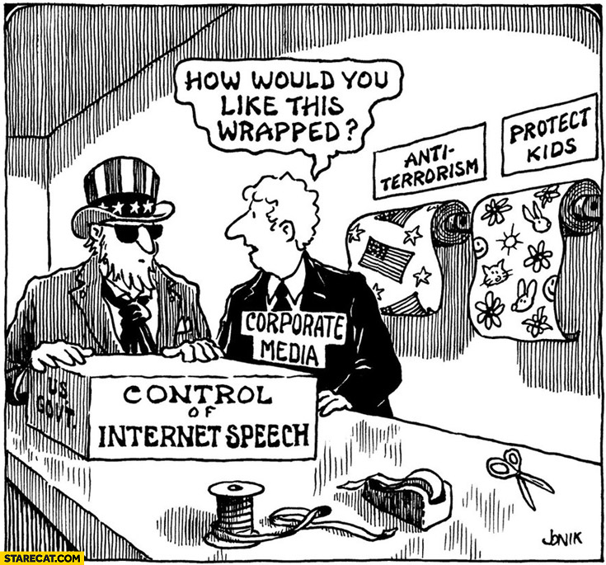
Why
Before 1996 - Illegal to export
Encryption ban proposal in the UK
Encryption ban proposal in EU
Encryption ban proposal in the US
I want to encrypt a few files
No encryption necessary, I just want to be sure email indeed comes from the person
I found a 0-day but company insists I use their OpenPGP to encrypt email before sending
I downloaded .iso or program, they suggest
to check signature, but I don’t know how

Slide 6
Terminology
PGP - Pretty Good Privacy Software. Proprietary, PGP Corp -> Symantec -> Broadcom
GPG - GNU Privacy Guard Software. Free and open-source
OpenPGP – Standard. PGP and GPG are OpenPGP-compliant
Plaintext - “Secret Message” or binary file, like photo
Ciphertext - “Frperg Zrffntr” encrypted text
Cipher - algorithm for performing encryption/decryption. ROT13: A-N, B-O, C-P
Hash - function map data of arbitrary size to fixed-size value output
Hash always has the same length for same hash algorithm (MD5, SHA256)
Change one bit in input, 50% different bits in hash
The same input always gives the same hash
One way function - cannot recover plaintext from a hash

Slide 7
Goals of PGP Cryptography
Confidentiality - message contents remain private
Integrity - refers to keeping a message unchanged
Nonrepudiation - person cannot deny signing a particular message
Authenticity - All these effects occurring simultaneously.

Slide 8
Main Usage Examples
Goal | How
I want anyone who reads this message to be sure I sent it and it was not changed (Nonrepudiation, Integrity) | Digitally sign the message with your private key
I want to verify the sender's identity | Verify signature with the sender’s public key.
I want to send a message that only my intended recipient can read (Confidentiality) | Encrypt the message with the recipient’s public key
I want to decrypt a message that I received | Decrypt the message with your private key
I want my message to be readable only by recipient, and I want recipient to be sure message came from me (Authenticity) | Encrypt the message with the recipient’s public key and digitally sign the message with your private key
I want to decrypt and verify a message that includes a digital signature | Decrypt the message with your private key and verify the signature with the sender’s public key

Slide 9
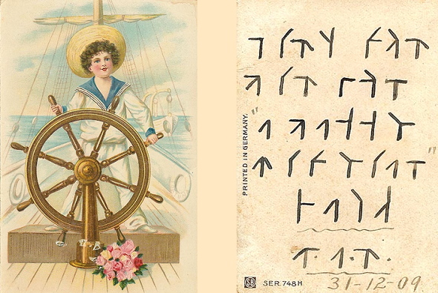
Confidentiality
Confidentiality means that the message contents remain private.
The plaintext cannot be viewed by anyone who doesn’t have the necessary keys.
In many cases, you cannot prevent someone from viewing the ciphertext,
because every message over the Internet can be viewed by a large number of people, just as postcards can be viewed by a postman or a neighbor.

Slide 10
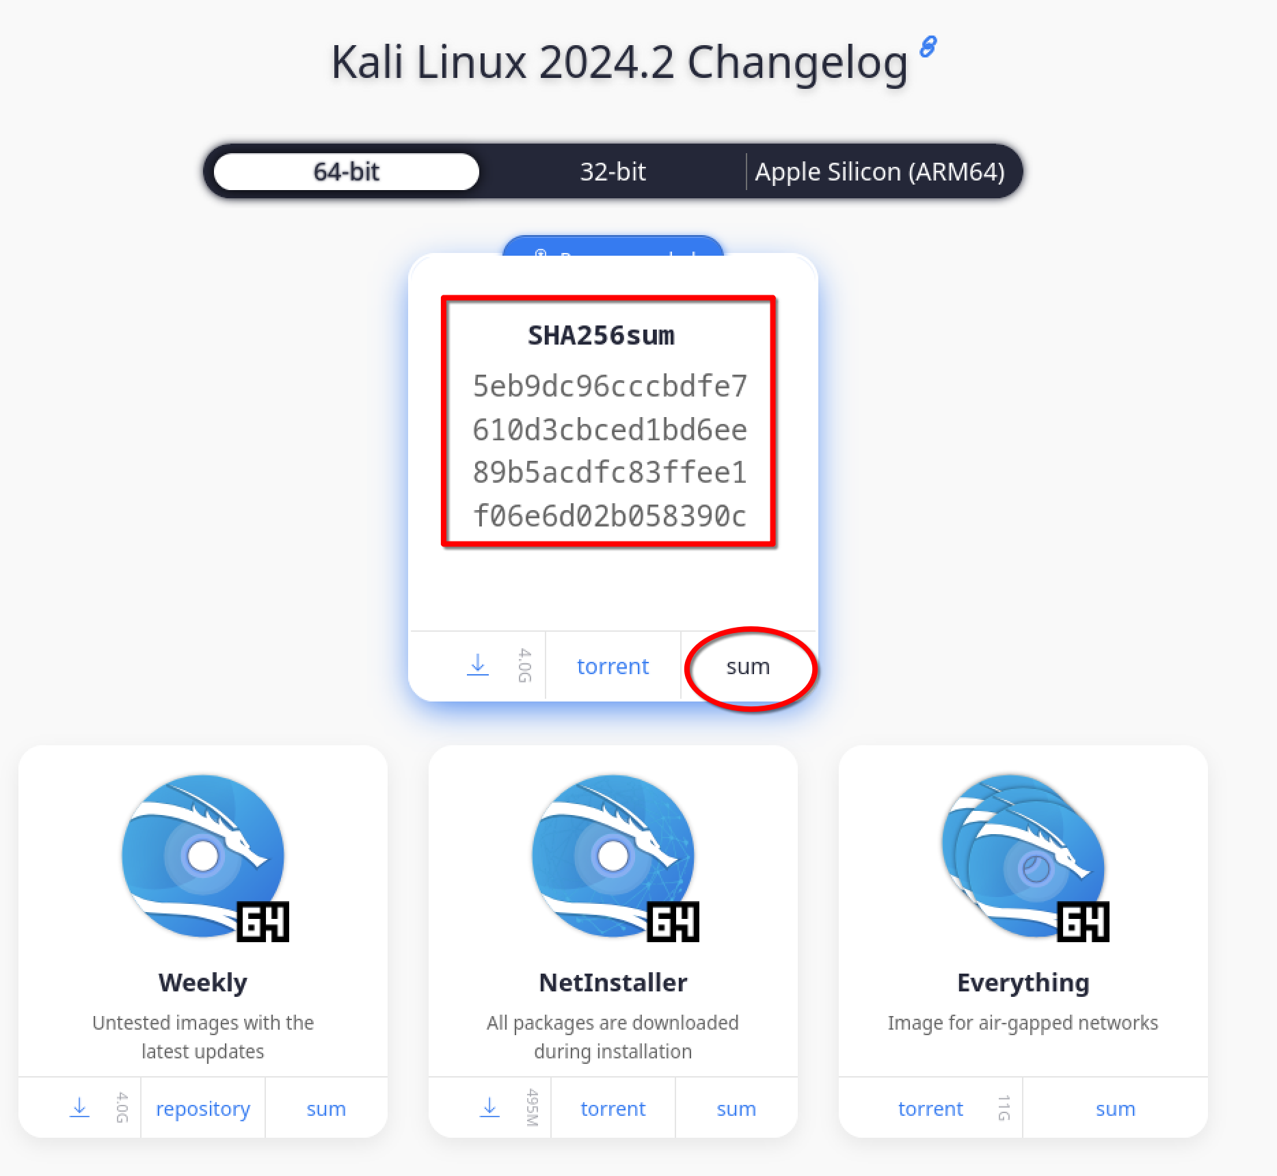
Integrity
Integrity refers to keeping a message unchanged. By using OpenPGP, you can confirm that a message has not been tampered with during transmission.

Slide 11
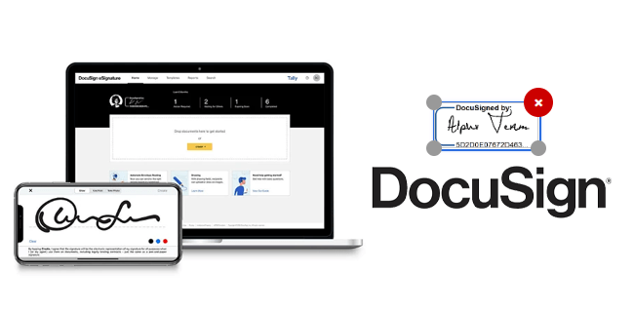
Nonrepudiation
Nonrepudiation means that a person cannot deny signing a particular message, which is especially important in the context of email.
Example of nonrepudiation:
Software vendors Sign program, drivers, .iso files
DocuSign

Slide 12
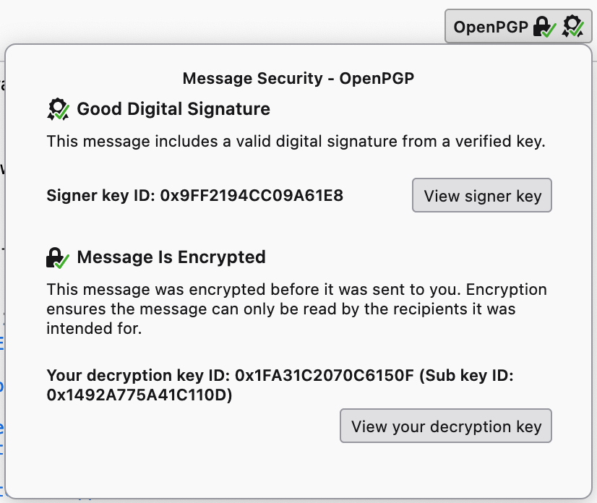
Authenticity
When you receive an email that has been encrypted and signed with OpenPGP, you know that the contents of the message have been concealed from any eavesdroppers. You know that the content of the message has not been changed. You also know that the message comes from the person who has the right to send such a message in the sender’s name

Slide 13
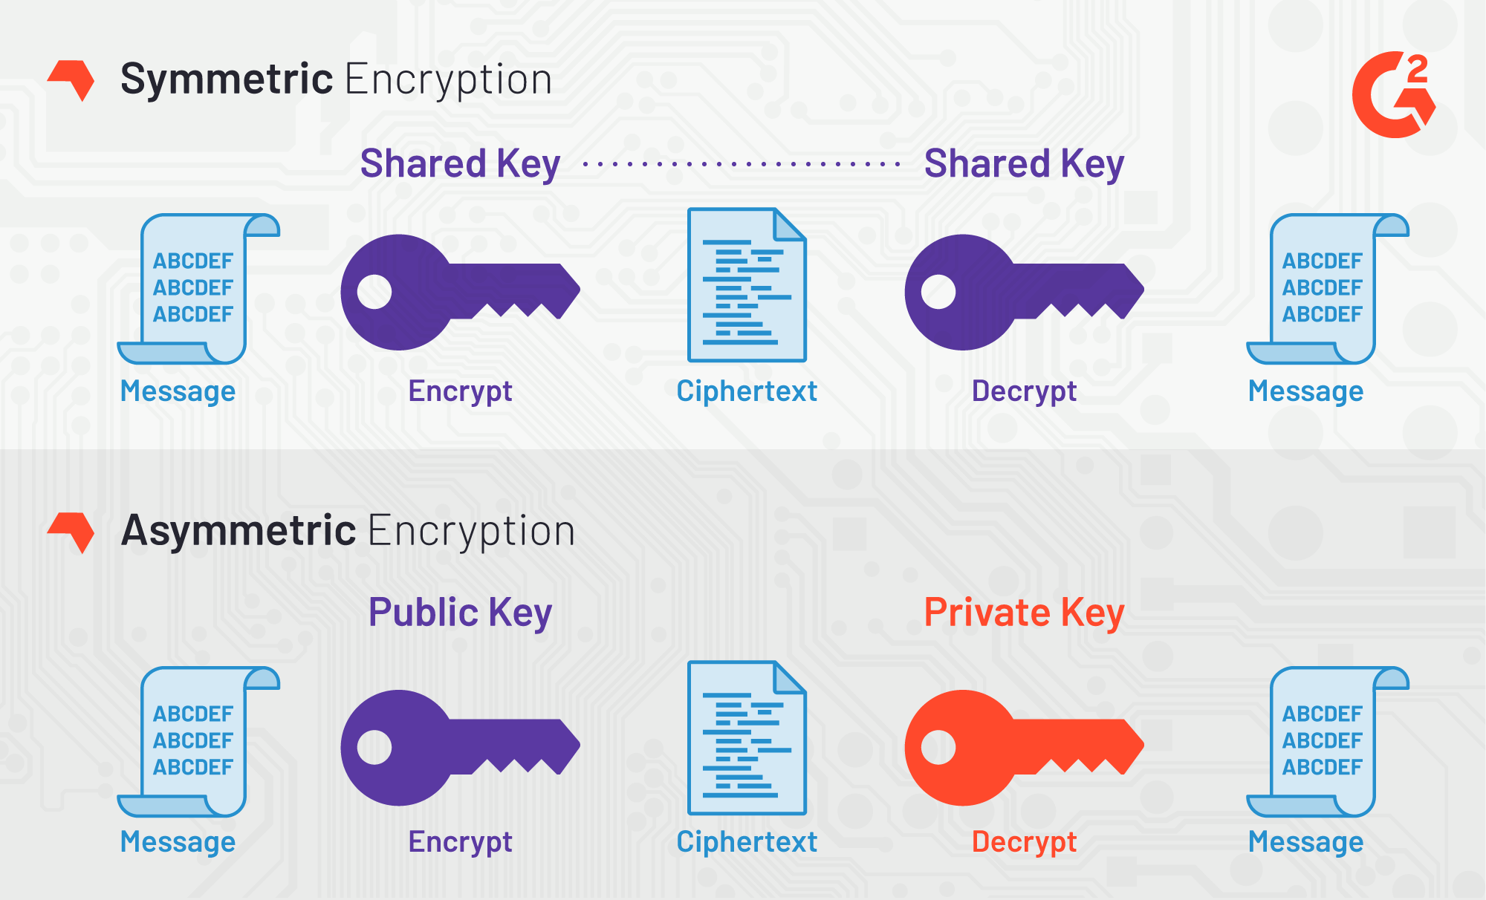
Symmetric vs Asymmetric Encryption

Slide 14
Asymmetric Cryptography
Pair of keys
Encrypt with one key, decrypt with another key.
You can encrypt with public key and decrypt with private key
You can encrypt with private key and decrypt with public key
Public key – share the key with anyone – Public-Key Cryptography
Private key – do not share, keep private
Keyserver – server that provides directory of OpenPGP keys

Slide 15
Thunderbird – easy way to start with OpenPGP
Thunderbird - https://www.thunderbird.net/
Mac:
brew install --cask thunderbird
Kali Linux (Thunderbird is probably installed already):
sudo apt update
sudo apt install thunderbird
Windows:
https://www.thunderbird.net/ Click Download. Install

Slide 16
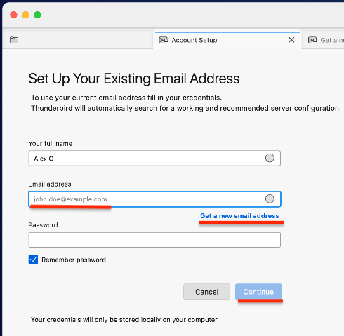
Thunderbird: Add Account
Sign in with your existing email
NOTE: For Google and Outlook
do not enter password, Click Continue

Slide 17
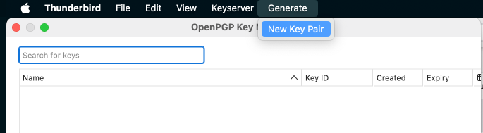
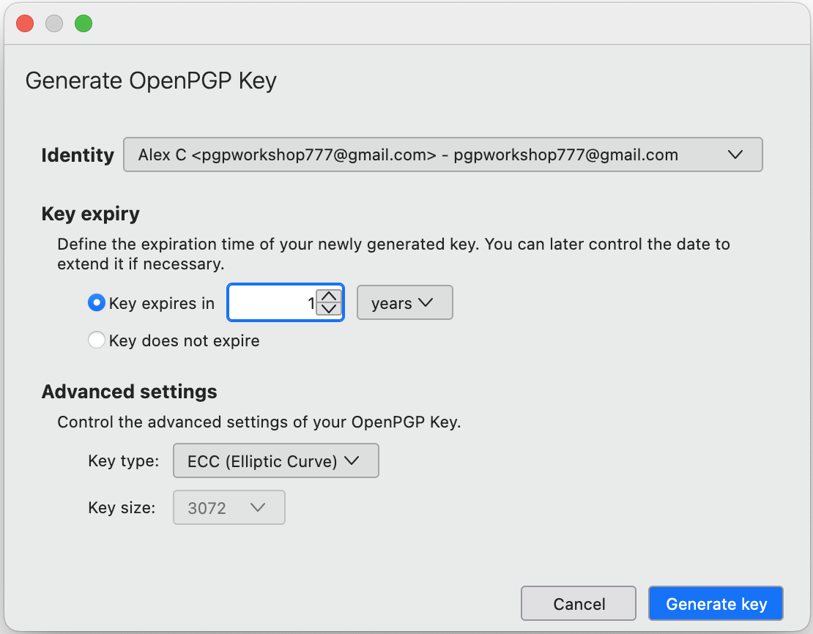
Thunderbird: Generate new Key Pair
In Thunderbird:
Tools -> OpenPGP Key Manager
Generate -> New Key Pair
Defaults will work
You may Expire your first keys in 1 year
and use ECC Key (much shorter)

Slide 18
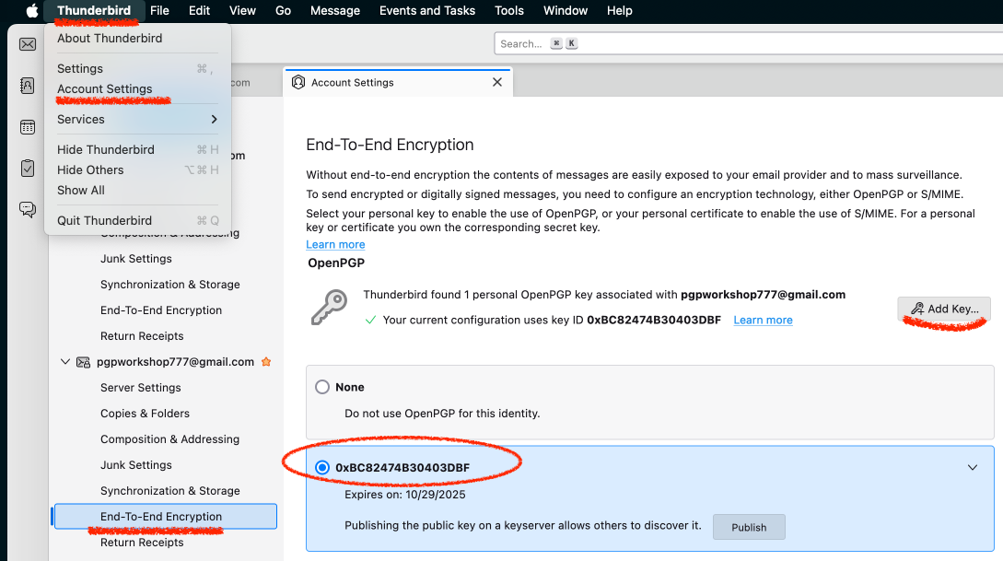
Thunderbird: use the OpenPGP Keys
In Thunderbird:
Thunderbird ->
Account Settings ->
End-To-End Encryption ->
Choose your Keys
May need to Add Key
(if keys do not shows up)

Slide 19
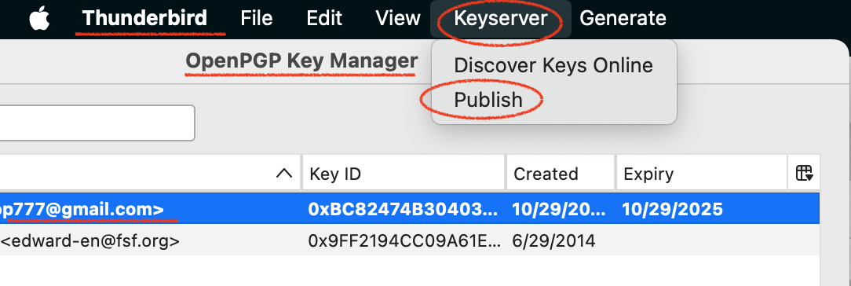
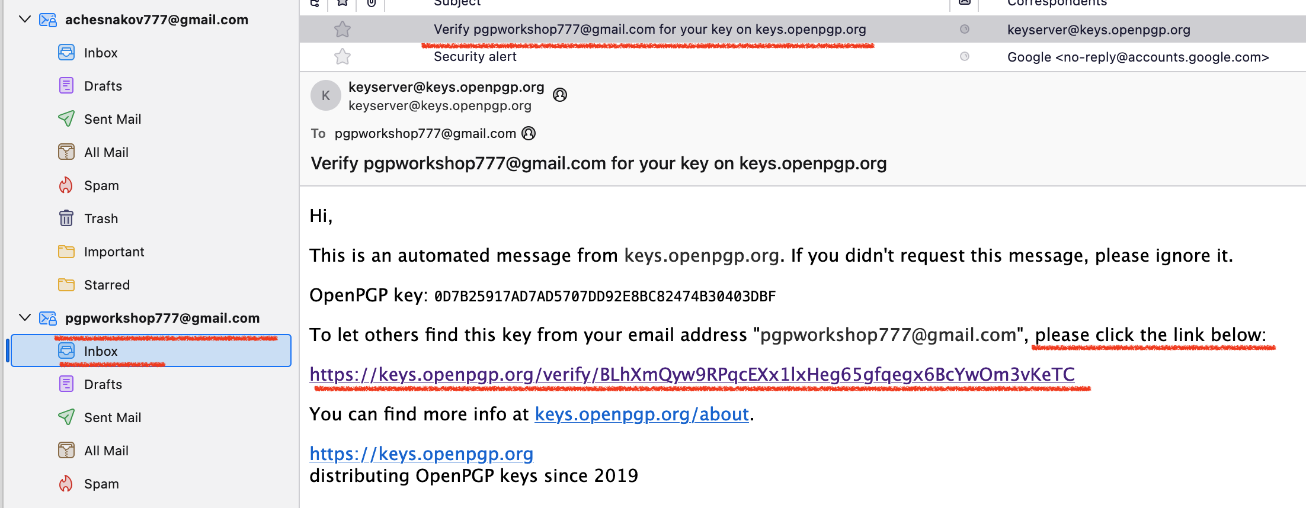
Publish Keys (Optional)
You may Publish the key
(Tools -> OpenPGP Key Manager->Keyserver)
This will help others find your OpenPGP keys
but gives away info about you (privacy)
You should receive an email and
confirm that you the owner of
this email account
This will make the key
discoverable through the search
at https://keys.openpgp.org/

Slide 20
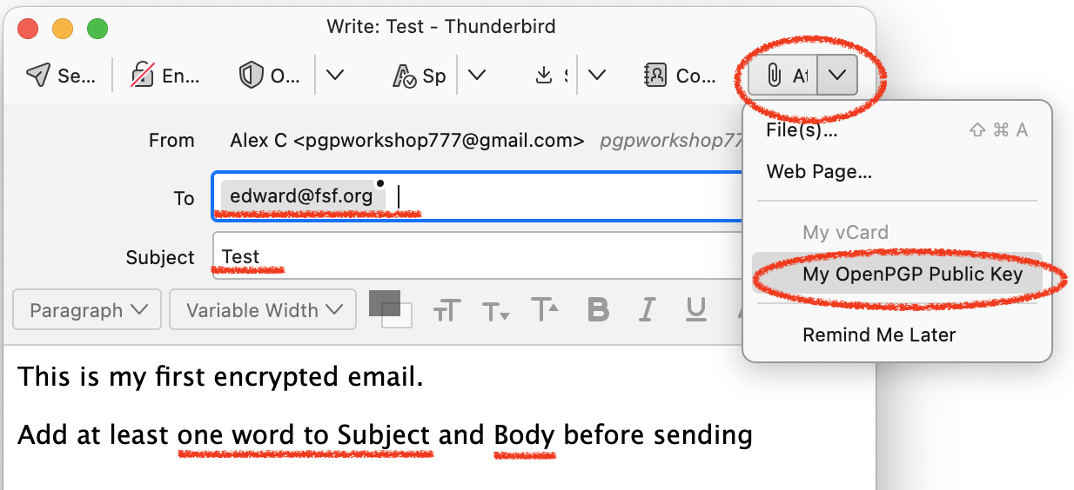
Email Edward your PubKey
Free Software Foundation (FSF)
project to help start with OpenPGP
Create email and attach Public Key
Add one word to Subject & Body
Sent to edward@fsf.org

Slide 21
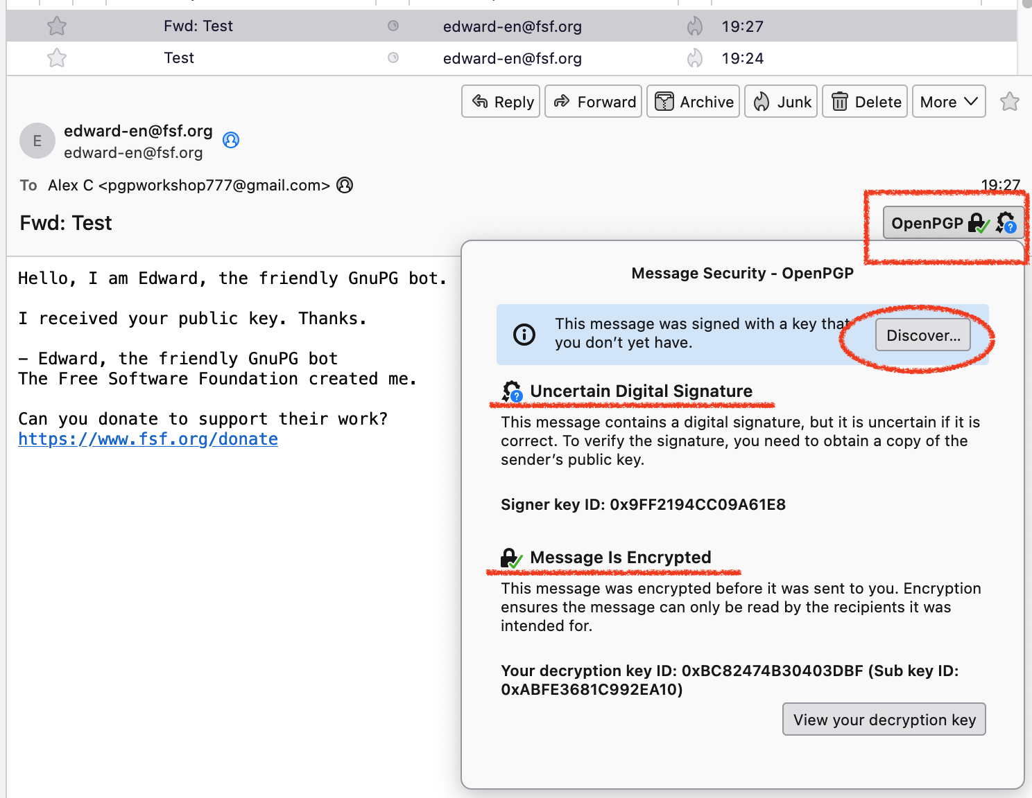
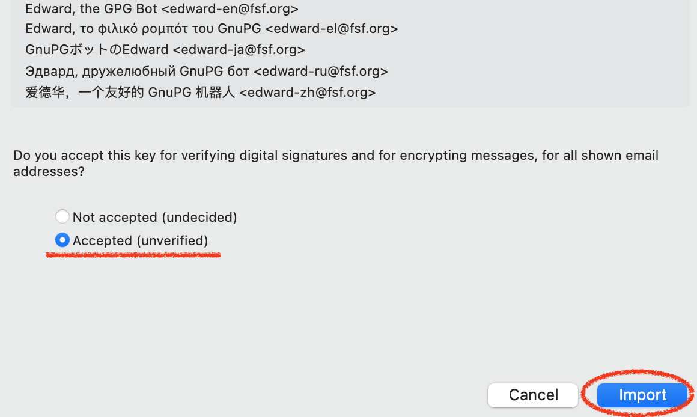
Receive First Encrypted Email
Congrats, you received Encrypted Email
Edward has our Public Key and can encrypt message with our PubKey
We haven’t added Edward’s PubKey so we are not sure if Edward is Edward
We can Click Discover
We initiated the email, we can Import and choose Import Accepted

Slide 22
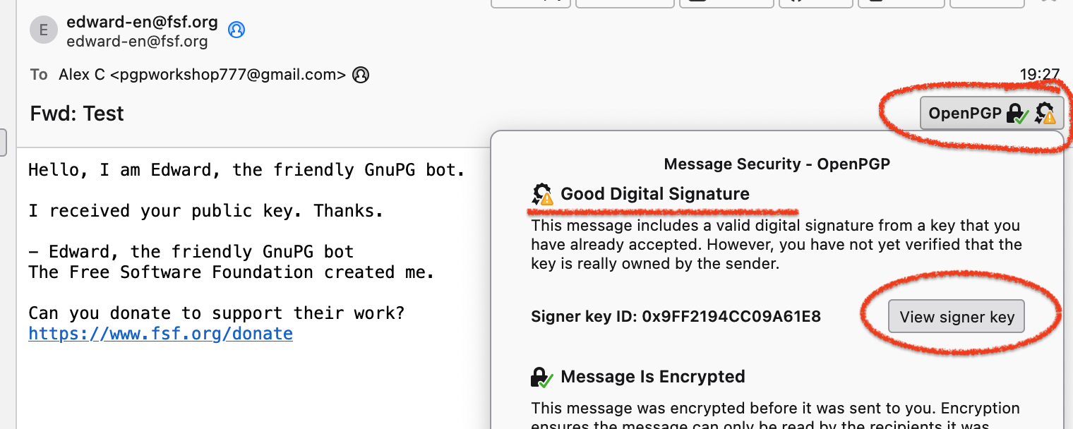
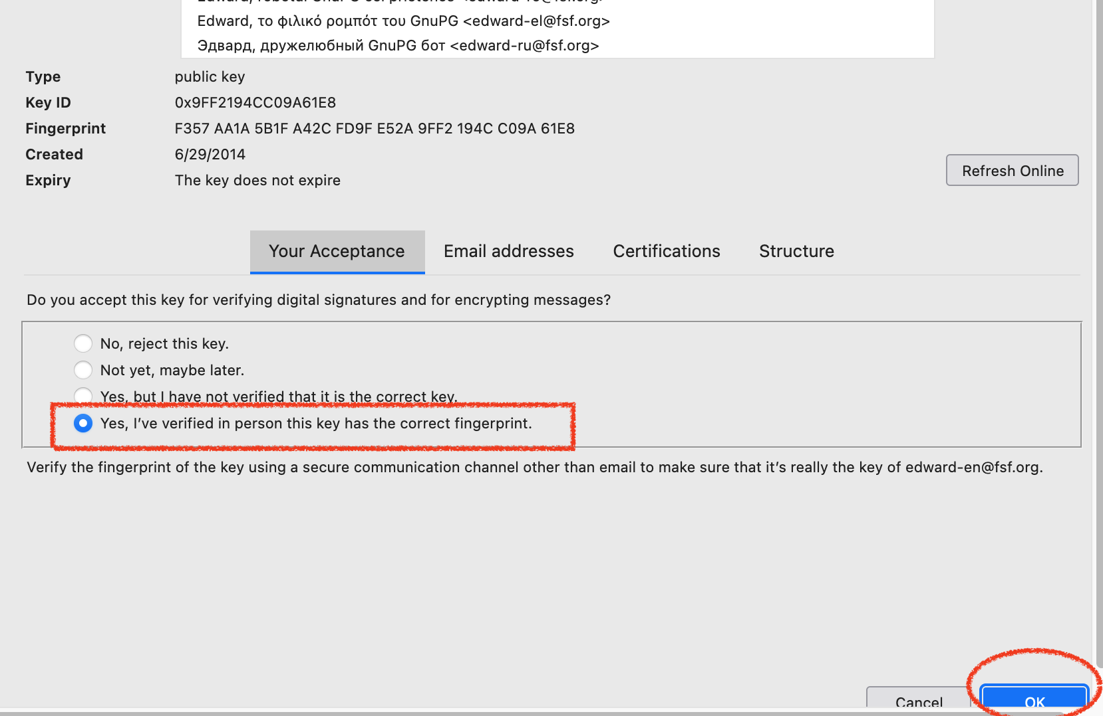
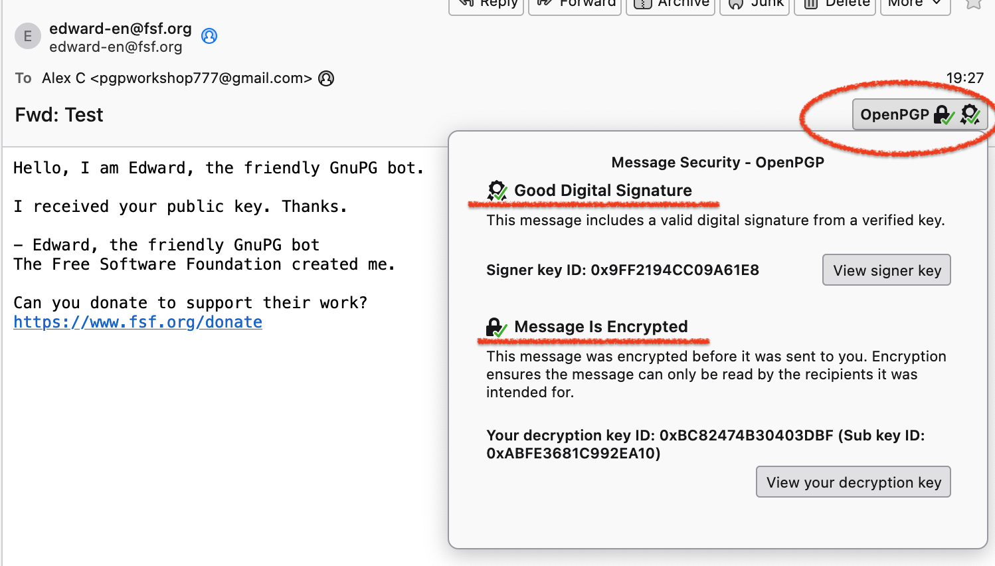
Verify Keys
After we accepted the Keys,
They are accepted, but not Verified.
We can Verify the keys and
get green marks.

Slide 23
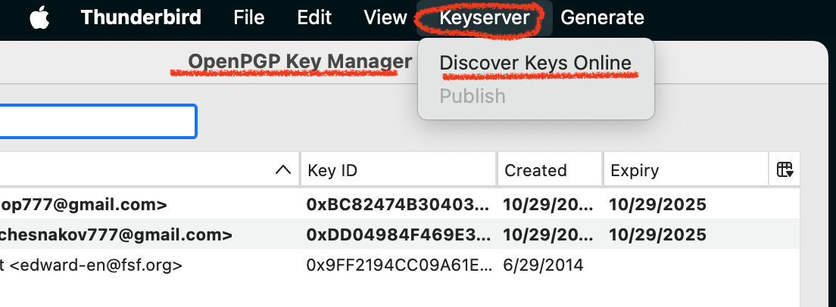
Discover PubKeys Online
Thunderbird->
Tools->
OpenPGP Key Manager->
Keyserver->
Discover Keys Online
Try to find and Import
edward-en@fsf.org
pgpworkshop777@gmail.com

Slide 24
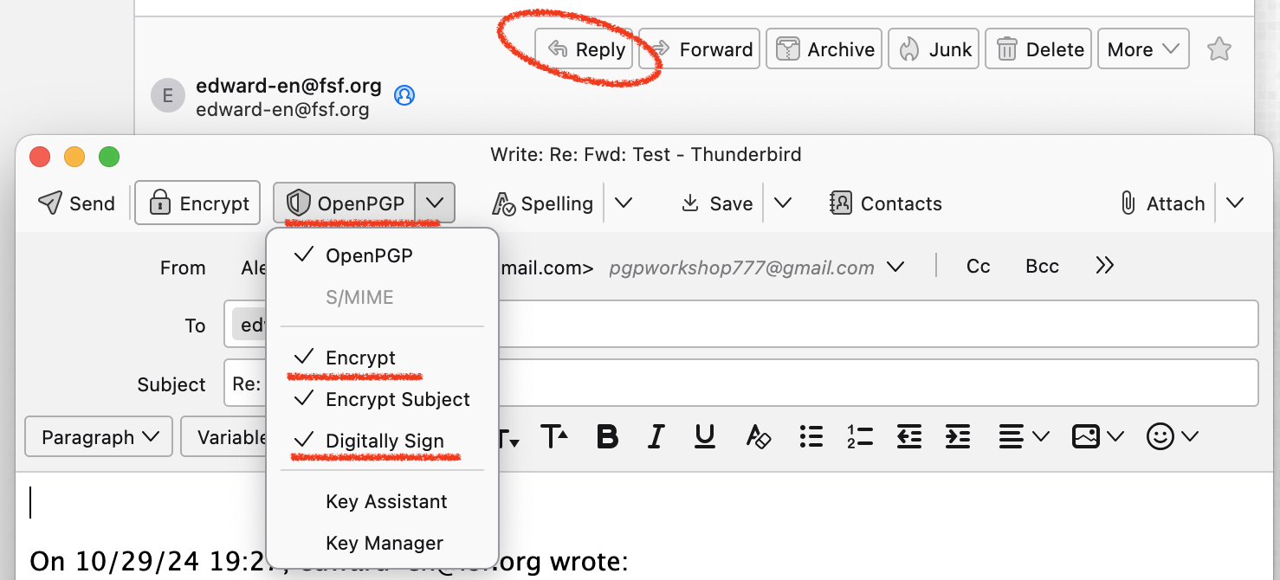
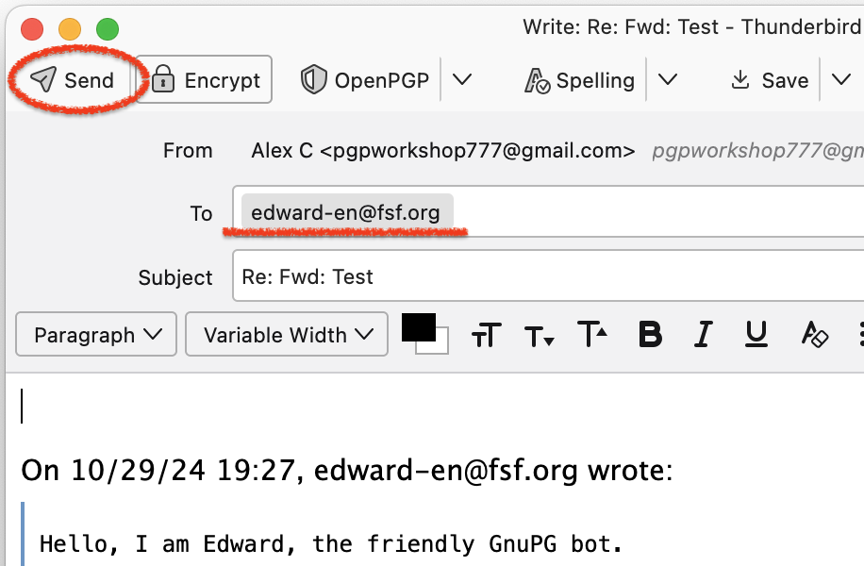
Send First Encrypted Email
Reply to Edward and be sure to:
Encrypt
Digitally Sign
Click Send

Slide 25
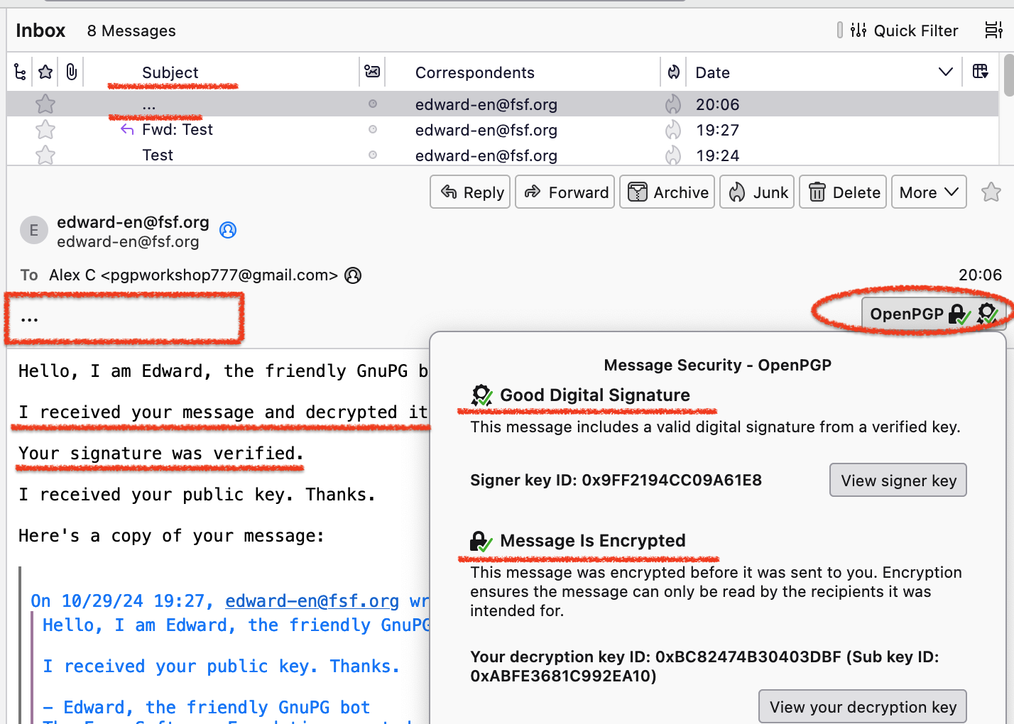
Receive an Encrypted Email from Edward
Receive a response message
Notice three dots instead of Subject

Slide 26
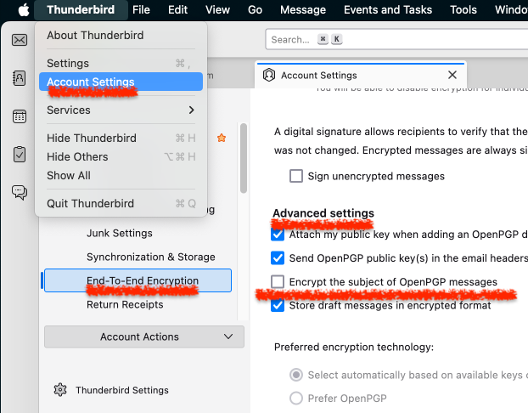
Subject Encryption
OpenPGP do not offer Encryption for Subject
Thunderbird encrypts Subject by default
They use non-standard implementation
Works fine between Thunderbird clients
Do not work between everything else
Choose a neutral subject like “Hello” or “Test”
Do not encrypt subject
Go to Account Settings->
End-To-End Encryption->
Advanced Settings->
Uncheck Encrypt Subject

Slide 27
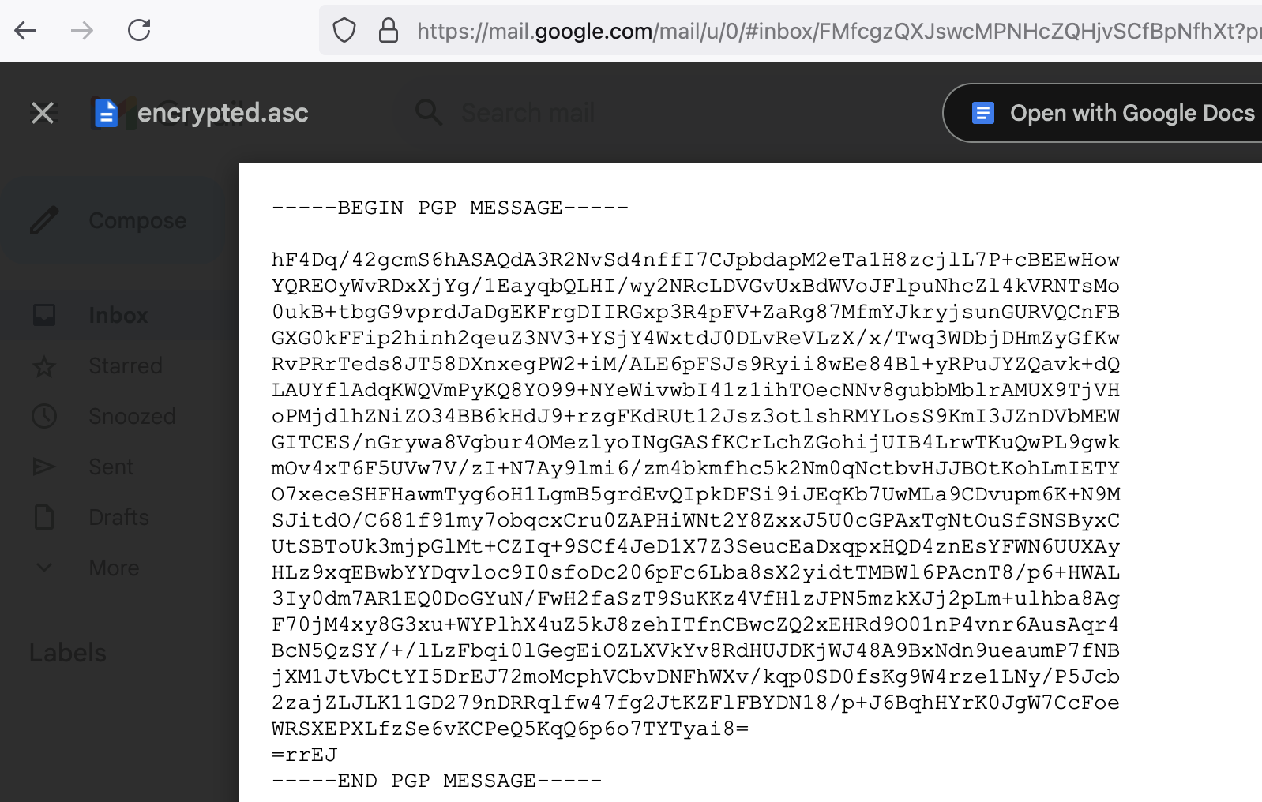
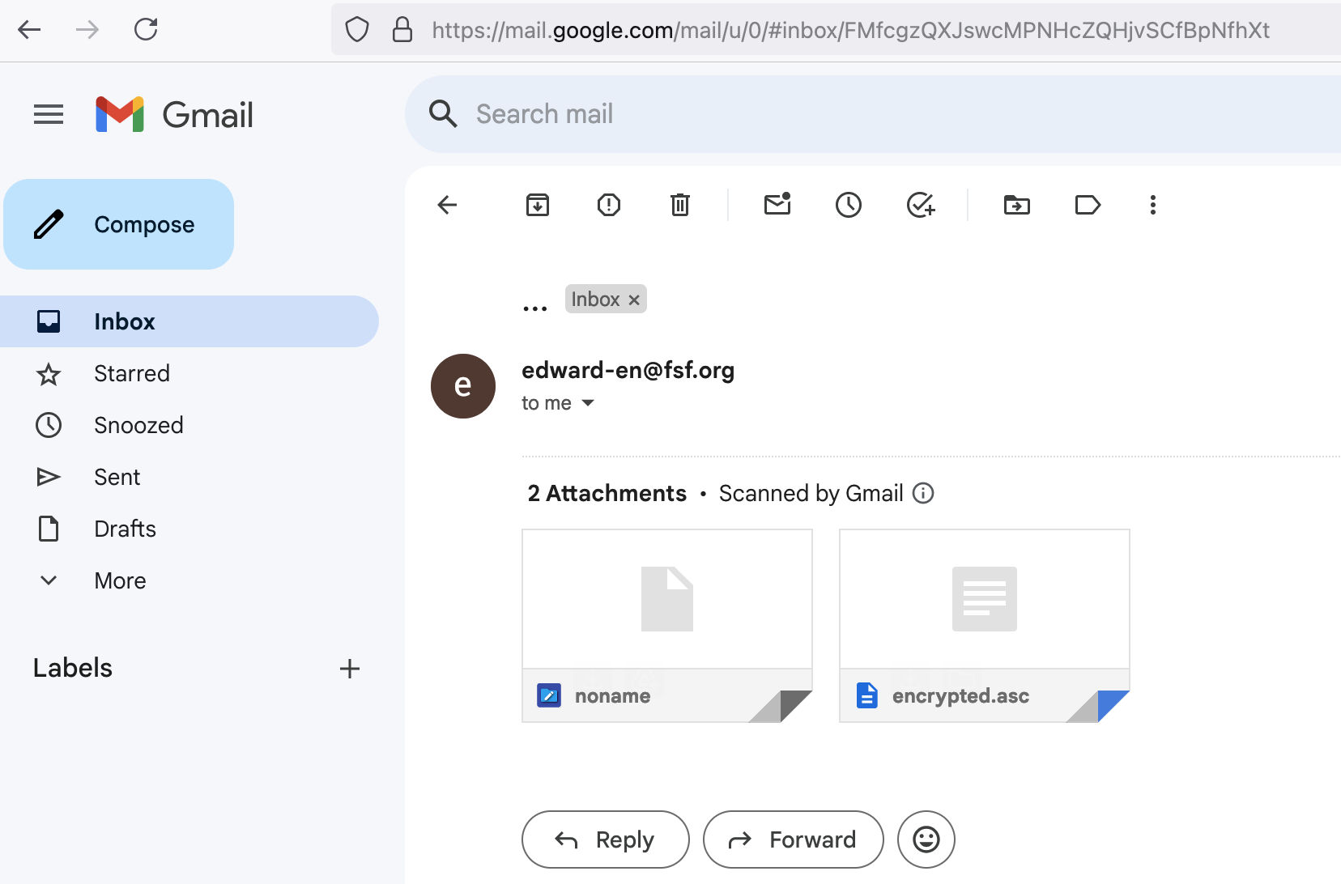
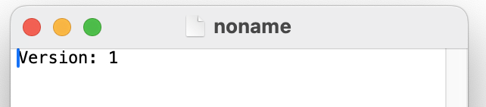
Check if email is encrypted
Log into email web portal
See how the message looks
Two attached files, no message body
- encrypted.asc
- noname

Slide 28
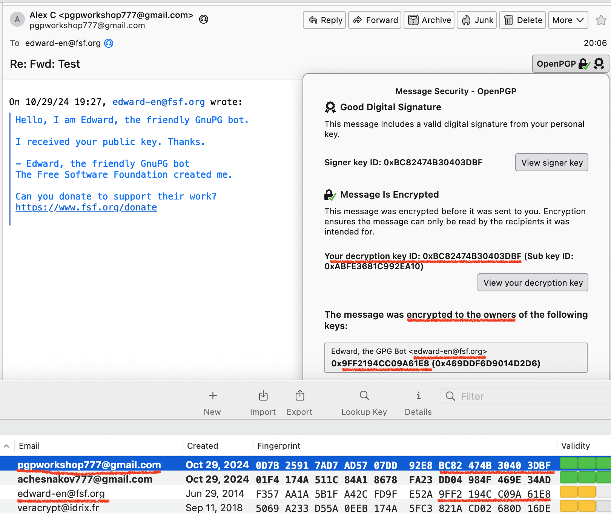
Why I can read the encrypted messages in the Sent folder?
We just discussed that message can
only be decrypted with the matching Key.
If we encrypted message with the Edward’s
Public Key, it could be decrypted with the
Edward’s Private Key only, right?
Magic of OpenPGP – we can encrypt with
multiple Public Key and decrypt with any
of the matching Private Key

Slide 29
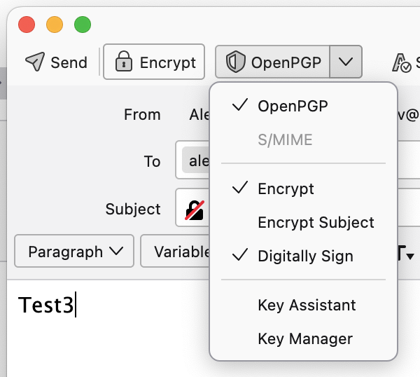
Exchange encrypted email with a person
Ask somebody around for their email that has OpenPGP keys
As a backup, you can send a email to me at pgpworkshop777@gmail.com
Search for their keys at Thunderbird's OpenPGP Key Manager
or at https://keys.openpgp.org/
Import keys
Click on the keys and Accept keys with "Yes, I've verified in person..."
Create a new email to this person
Be sure you Encrypt and Digitally sign the message
Other person:
Receive the email
Import Keys
Click Reply to the email
Encrypt and Digitally Sign the email before Sending

Slide 30
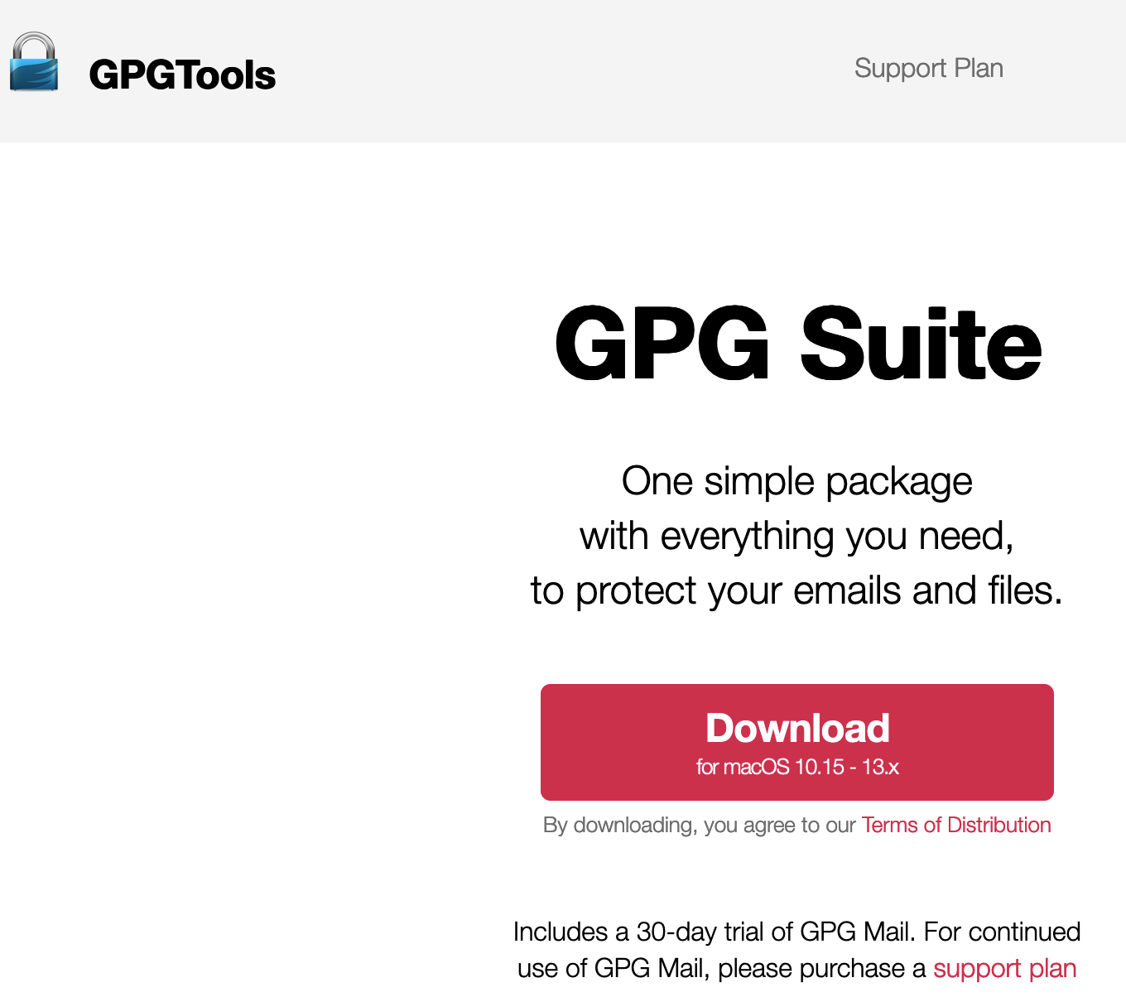
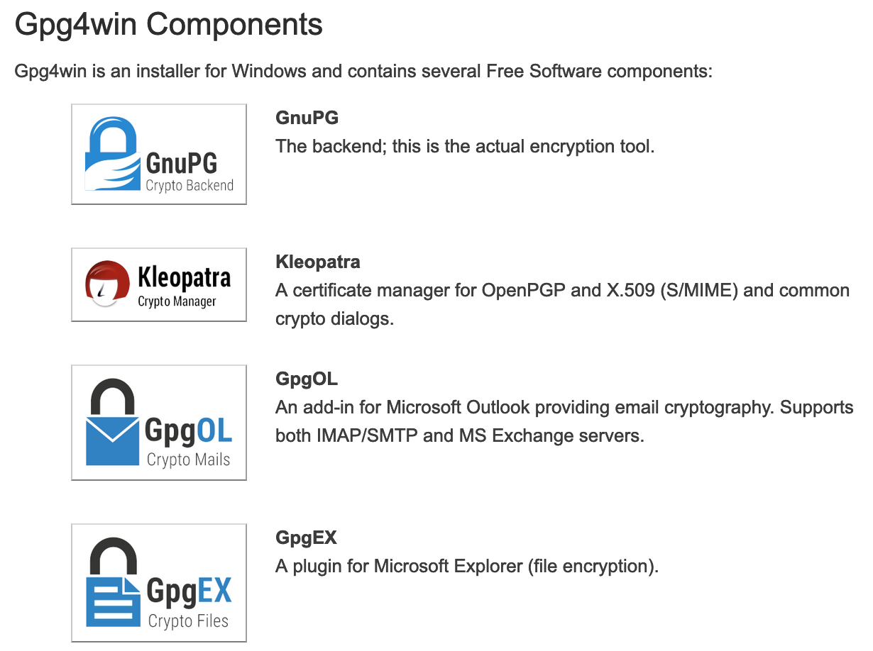
Advanced use of GnuPG (GPG)

Slide 31
Install GnuPG (CLI) and GUI tools
GnuPG - https://gnupg.org/
Mac. GPG Suite. Includes CLI and GUI:
brew install --cask gpg-suite
Kali Linux. GnuPG and Kleopatra (gpg is pre-installed):
sudo apt update
sudo apt install gpg kleopatra
Windows. Gpg4win. Includes GnuPG and Kleopatra:
https://gpg4win.org/ Click Download. Install

Slide 32
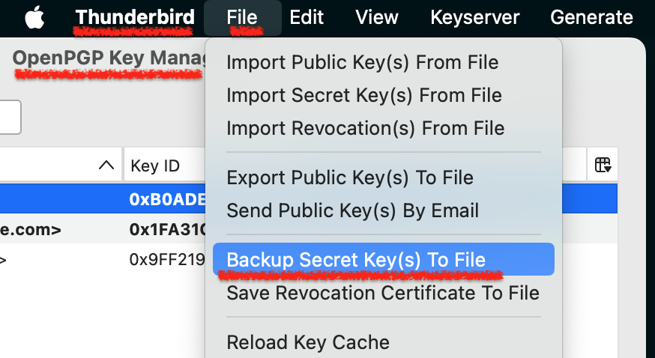
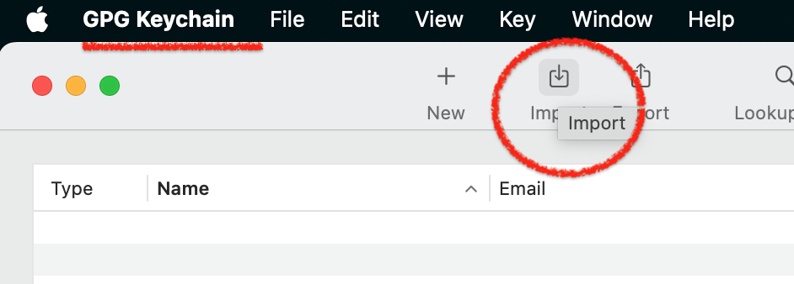
Export Keys from Thunderbird to GnuPG
Thunderbird can’t sync keys with GnuPG
Export Secret (Private) Keys from Thunderbird
- Thunderbird will export Private and Pub Keys
Choose Password for Private (Secret) Keys
Import keys to GPG Keychain or Kleopatra

Slide 33
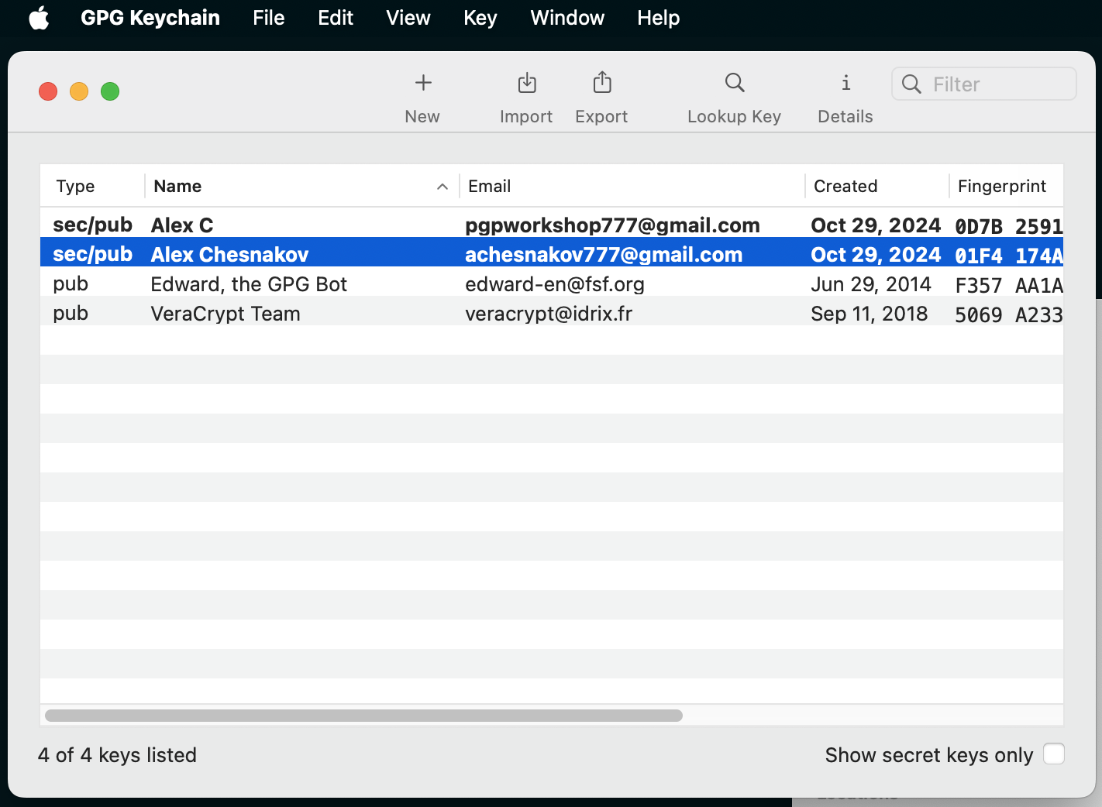
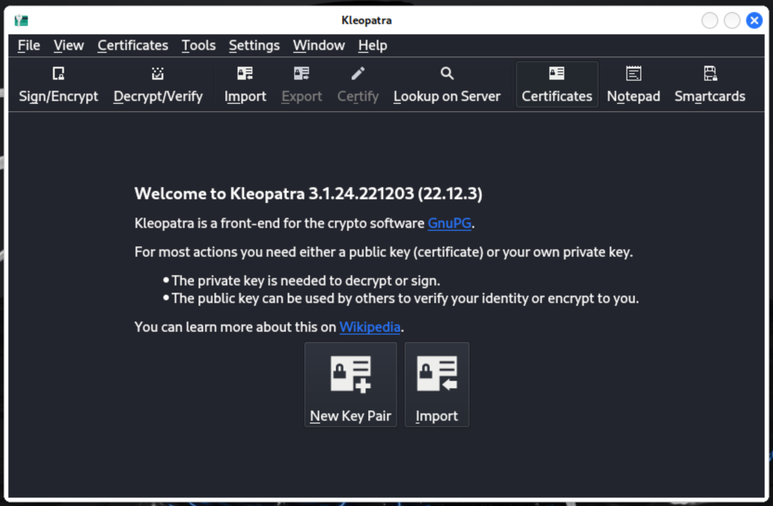
CLI vs GUI
CLI version offers full functionality
For simple use both CLI and GUI are good
CLI version can be used in scripts and automation
macOS Linux / Windows

Slide 34
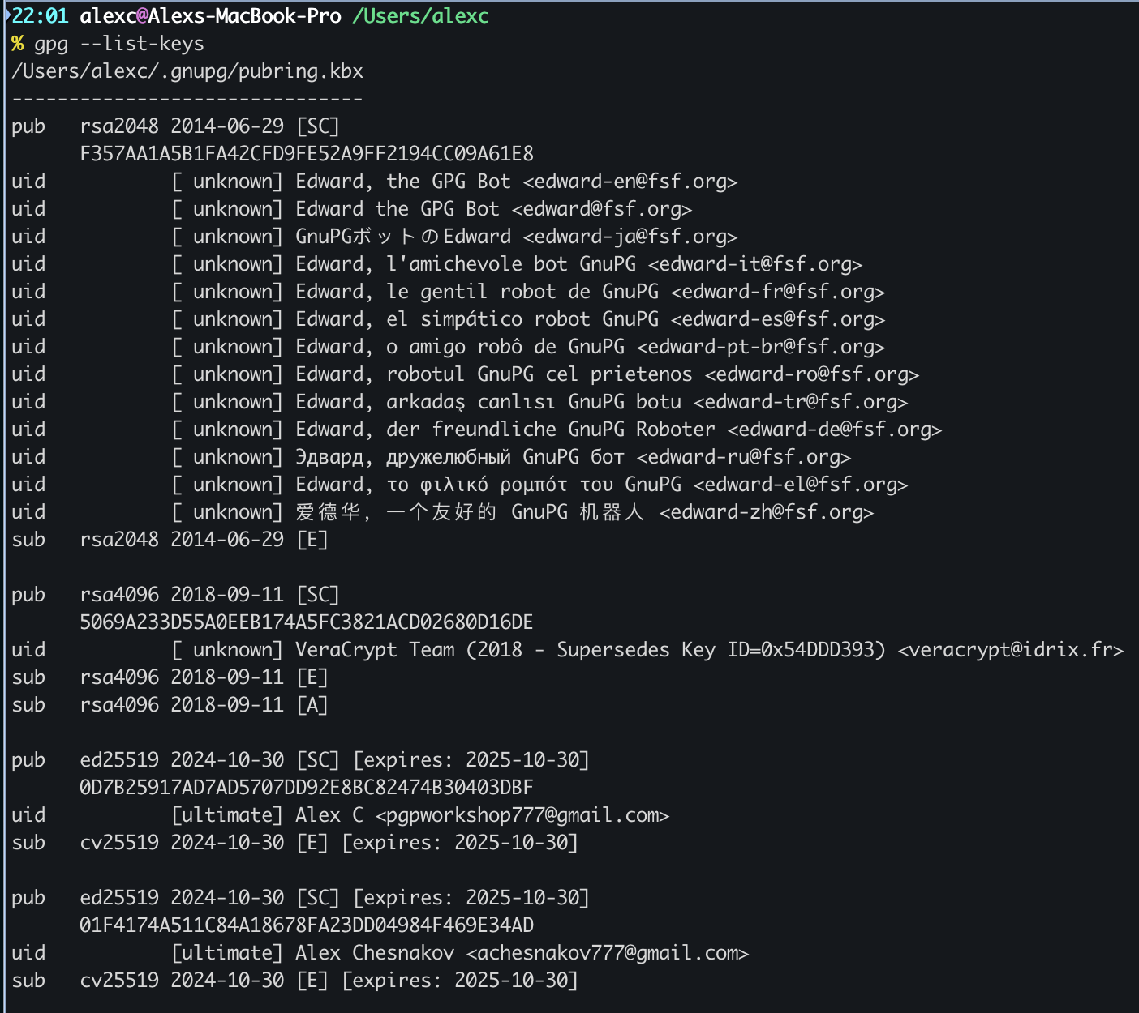
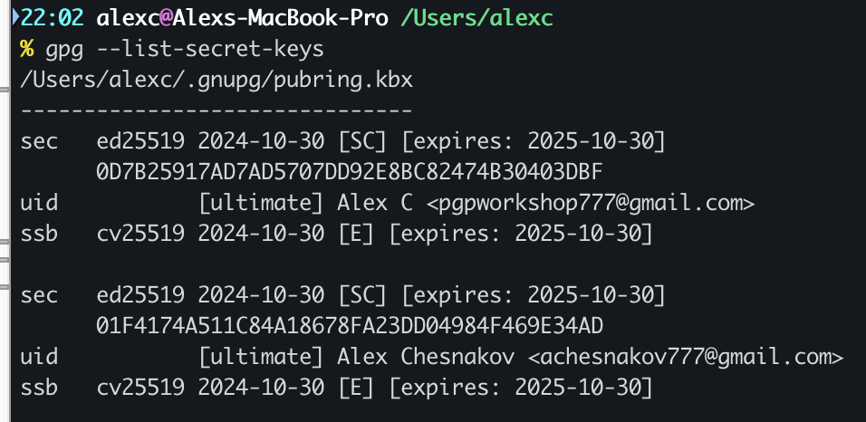
List Keys
gpg --list-keys – List Public Keys
gpg --list-secret-keys – List Private Keys

Slide 35
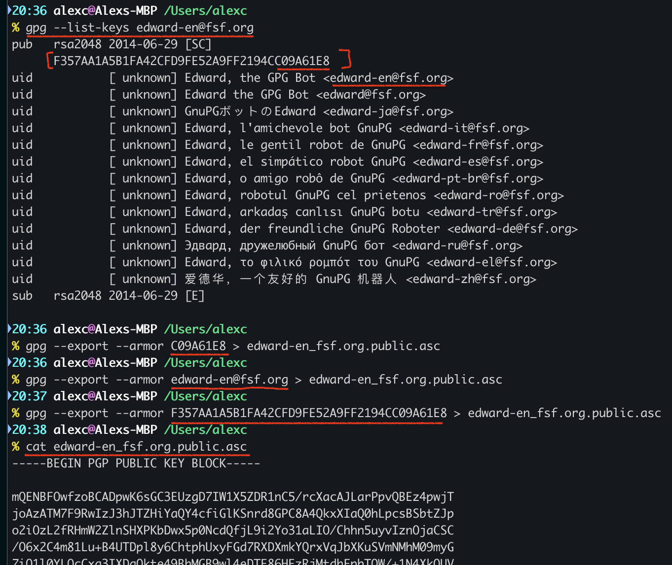
Export Keys
gpg --export-secret-keys --armor [keyID] > my_pgpkey.private.asc
gpg --export --armor [keyID] > my_pgpkey.public.asc
[keyID] – Last 8 or 16 digits of Fingerprint
may use Email Address
or Full Fingerprint
--armor – Export as ASCII text

Slide 36
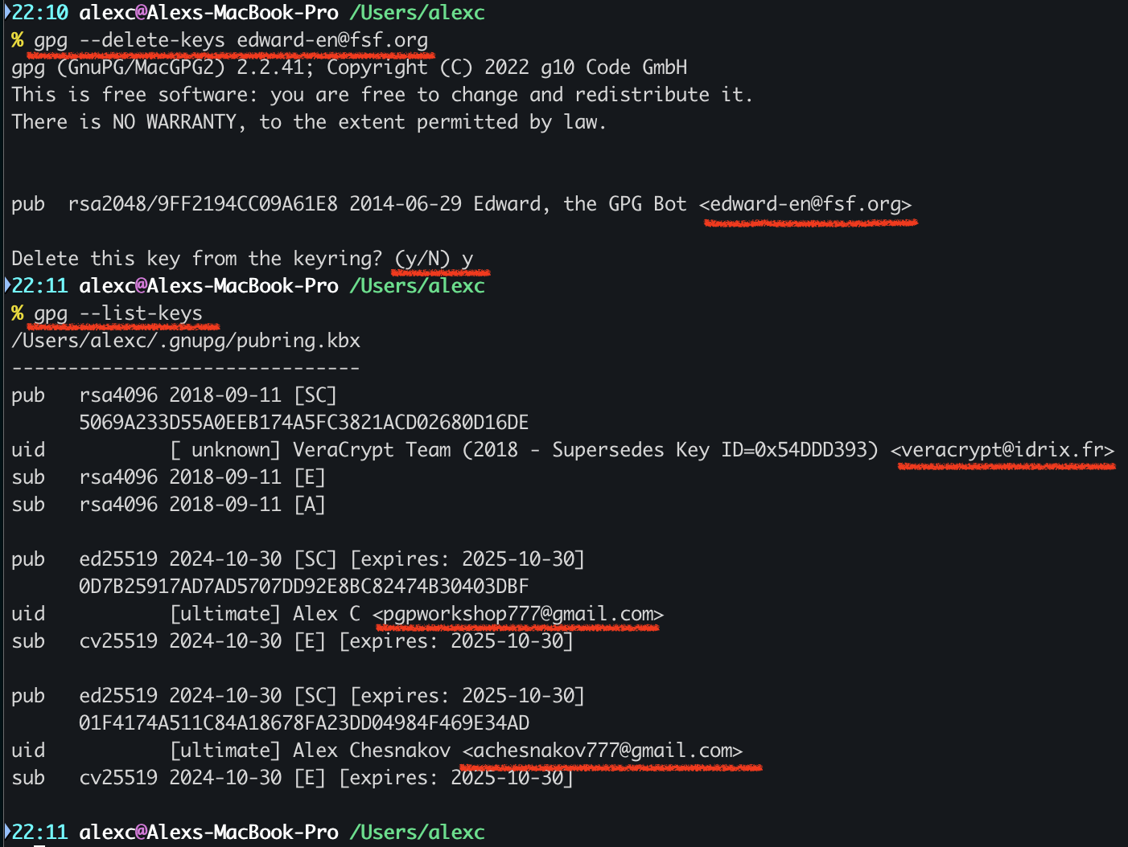
Delete Keys
gpg --delete-secret-keys [keyID]
gpg --delete-keys [keyID]
[keyID] – Last 8 or 16 digits of Fingerprint
may use Email Address
or Full Fingerprint

Slide 37
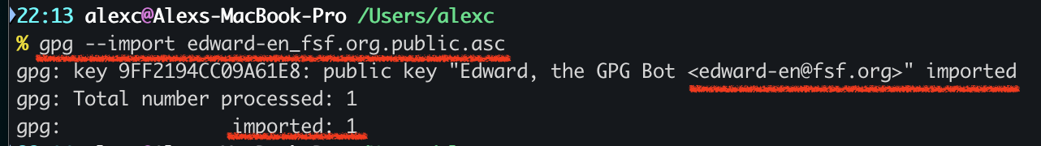
Import Keys
gpg --import my_pgpkey.private.asc
gpg --import my_pgpkey.public.asc

Slide 38
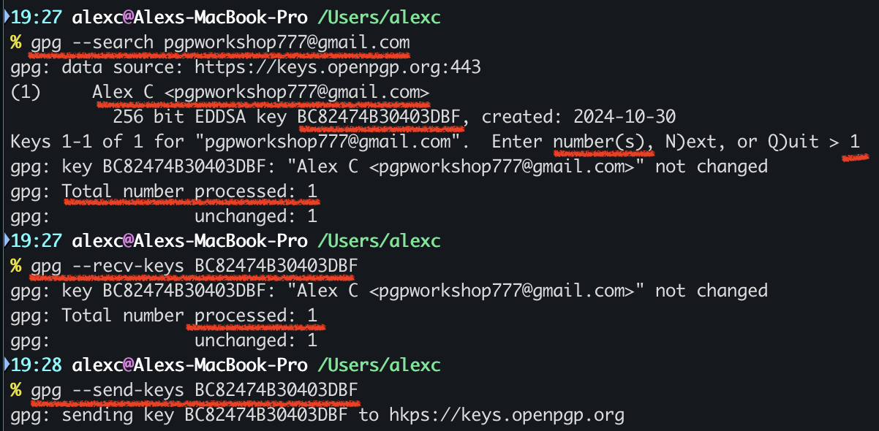
Keyservers
gpg --keyserver hkps://keys.openpgp.org --search edward-en@fsf.org
We can skip --keyserver hkps://keys.openpgp.org
if we are using default keys.openpgp.org server,
not custom, like pgp.mit.edu
gpg --search pgpworkshop777@gmail.com
Email address may have multiple Keys,
need to specify specific Key
gpg --recv-keys BC82474B30403DBF
ggpg --send-keys BC82474B30403DBF

Slide 39
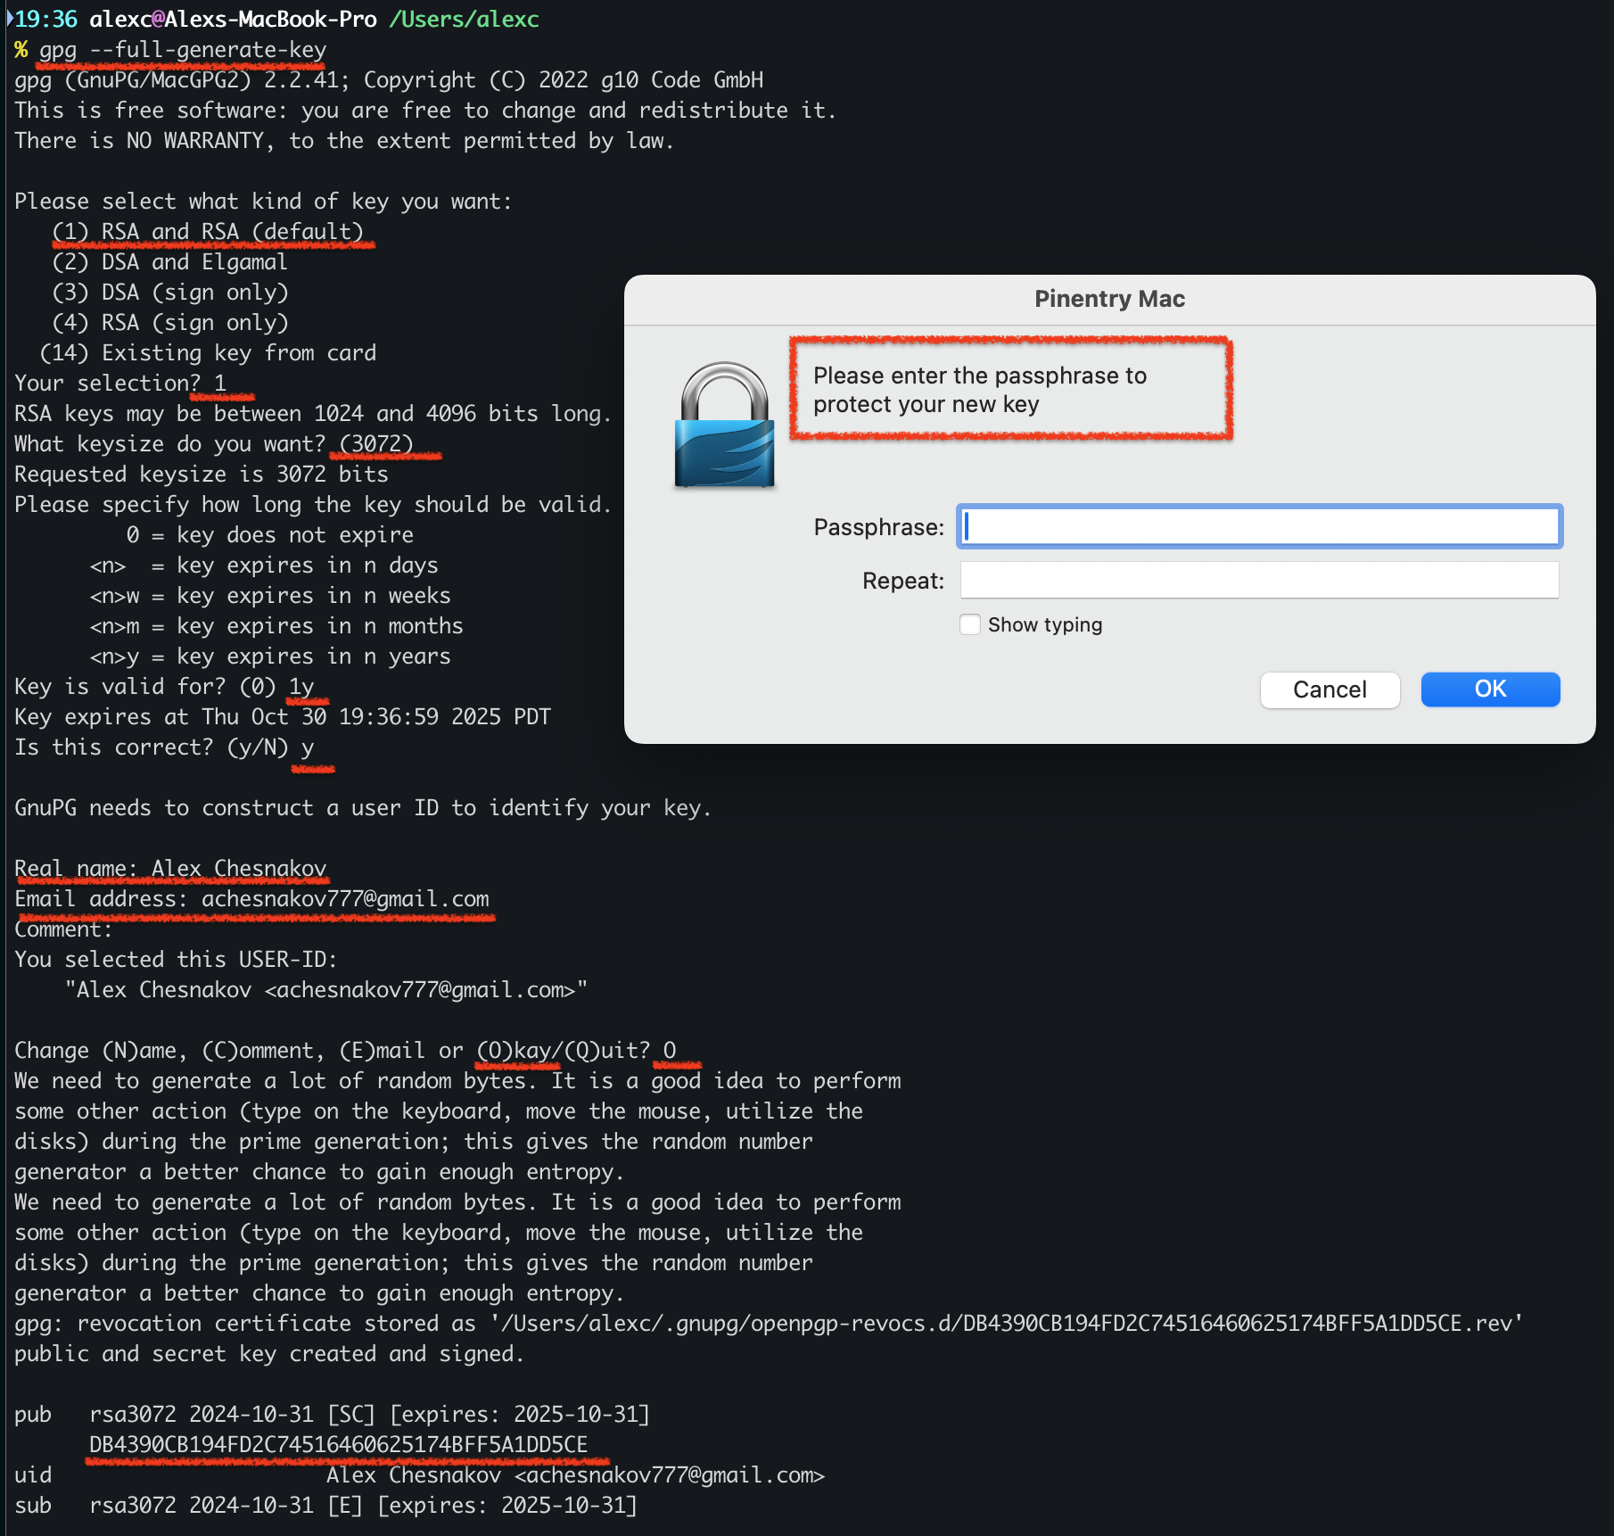
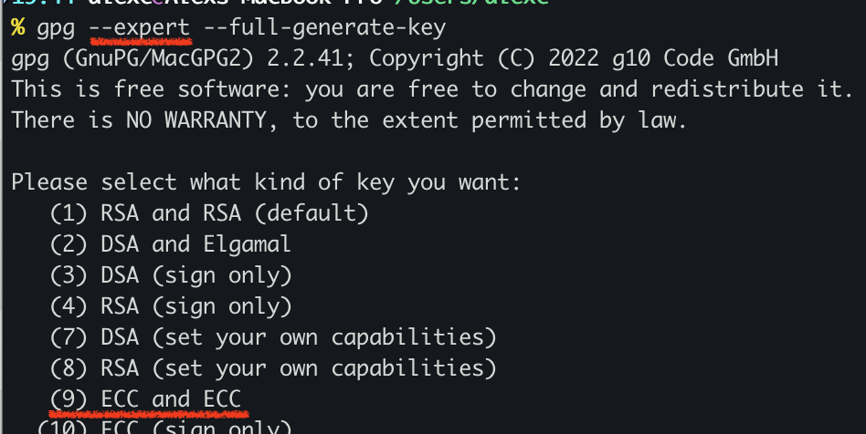
Generate Keys
gpg --full-generate-key
Revocation Certificate:
Save it in a safe place
Upload to keyserve
if you lost your Private Key
Decryption will still work
after you upload Rev.Cert.
Somebody need to search
keyserver to notice that
the key was revoked

Slide 40
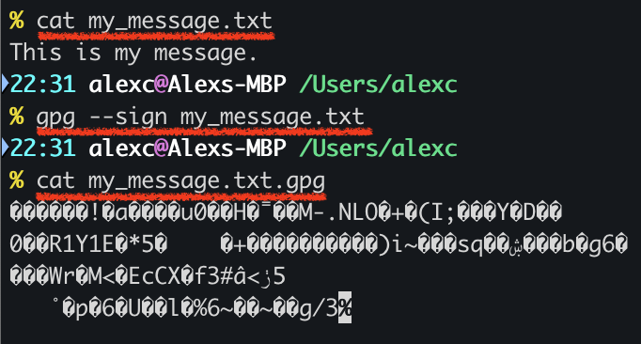
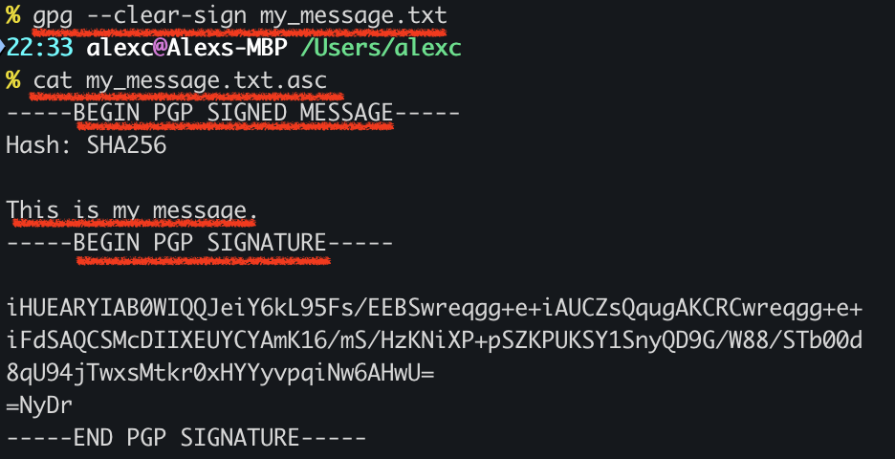
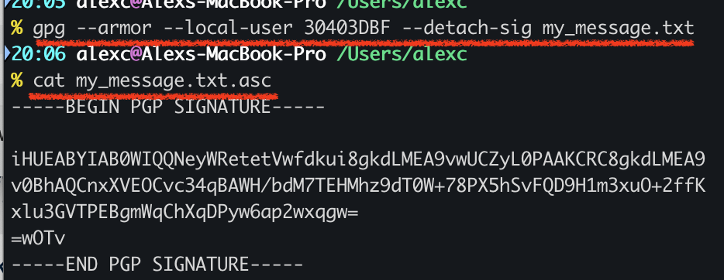
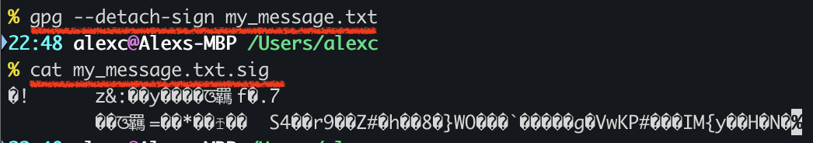
Sign the message / file
gpg --sign file
output: file.gpg (input file + signature, binary)
gpg --clear-sign file
output: file.asc (original message + ascii signature)
gpg --detach-sign file
output: file.sig (separate signature, binary)
gpg --armor --local-user 30403DBF --detach-sig file
output: file.asc (specify private key, separate signature, ascii)

Slide 41
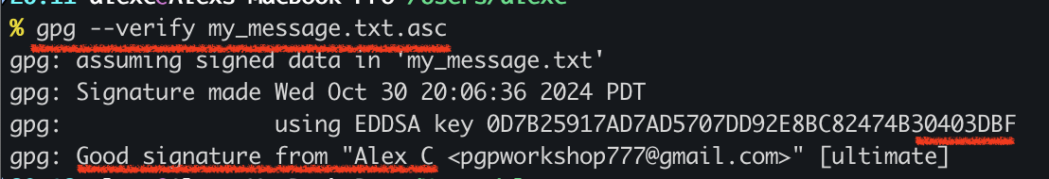
Verify Signature
gpg --verify my_message.txt.sig

Slide 42
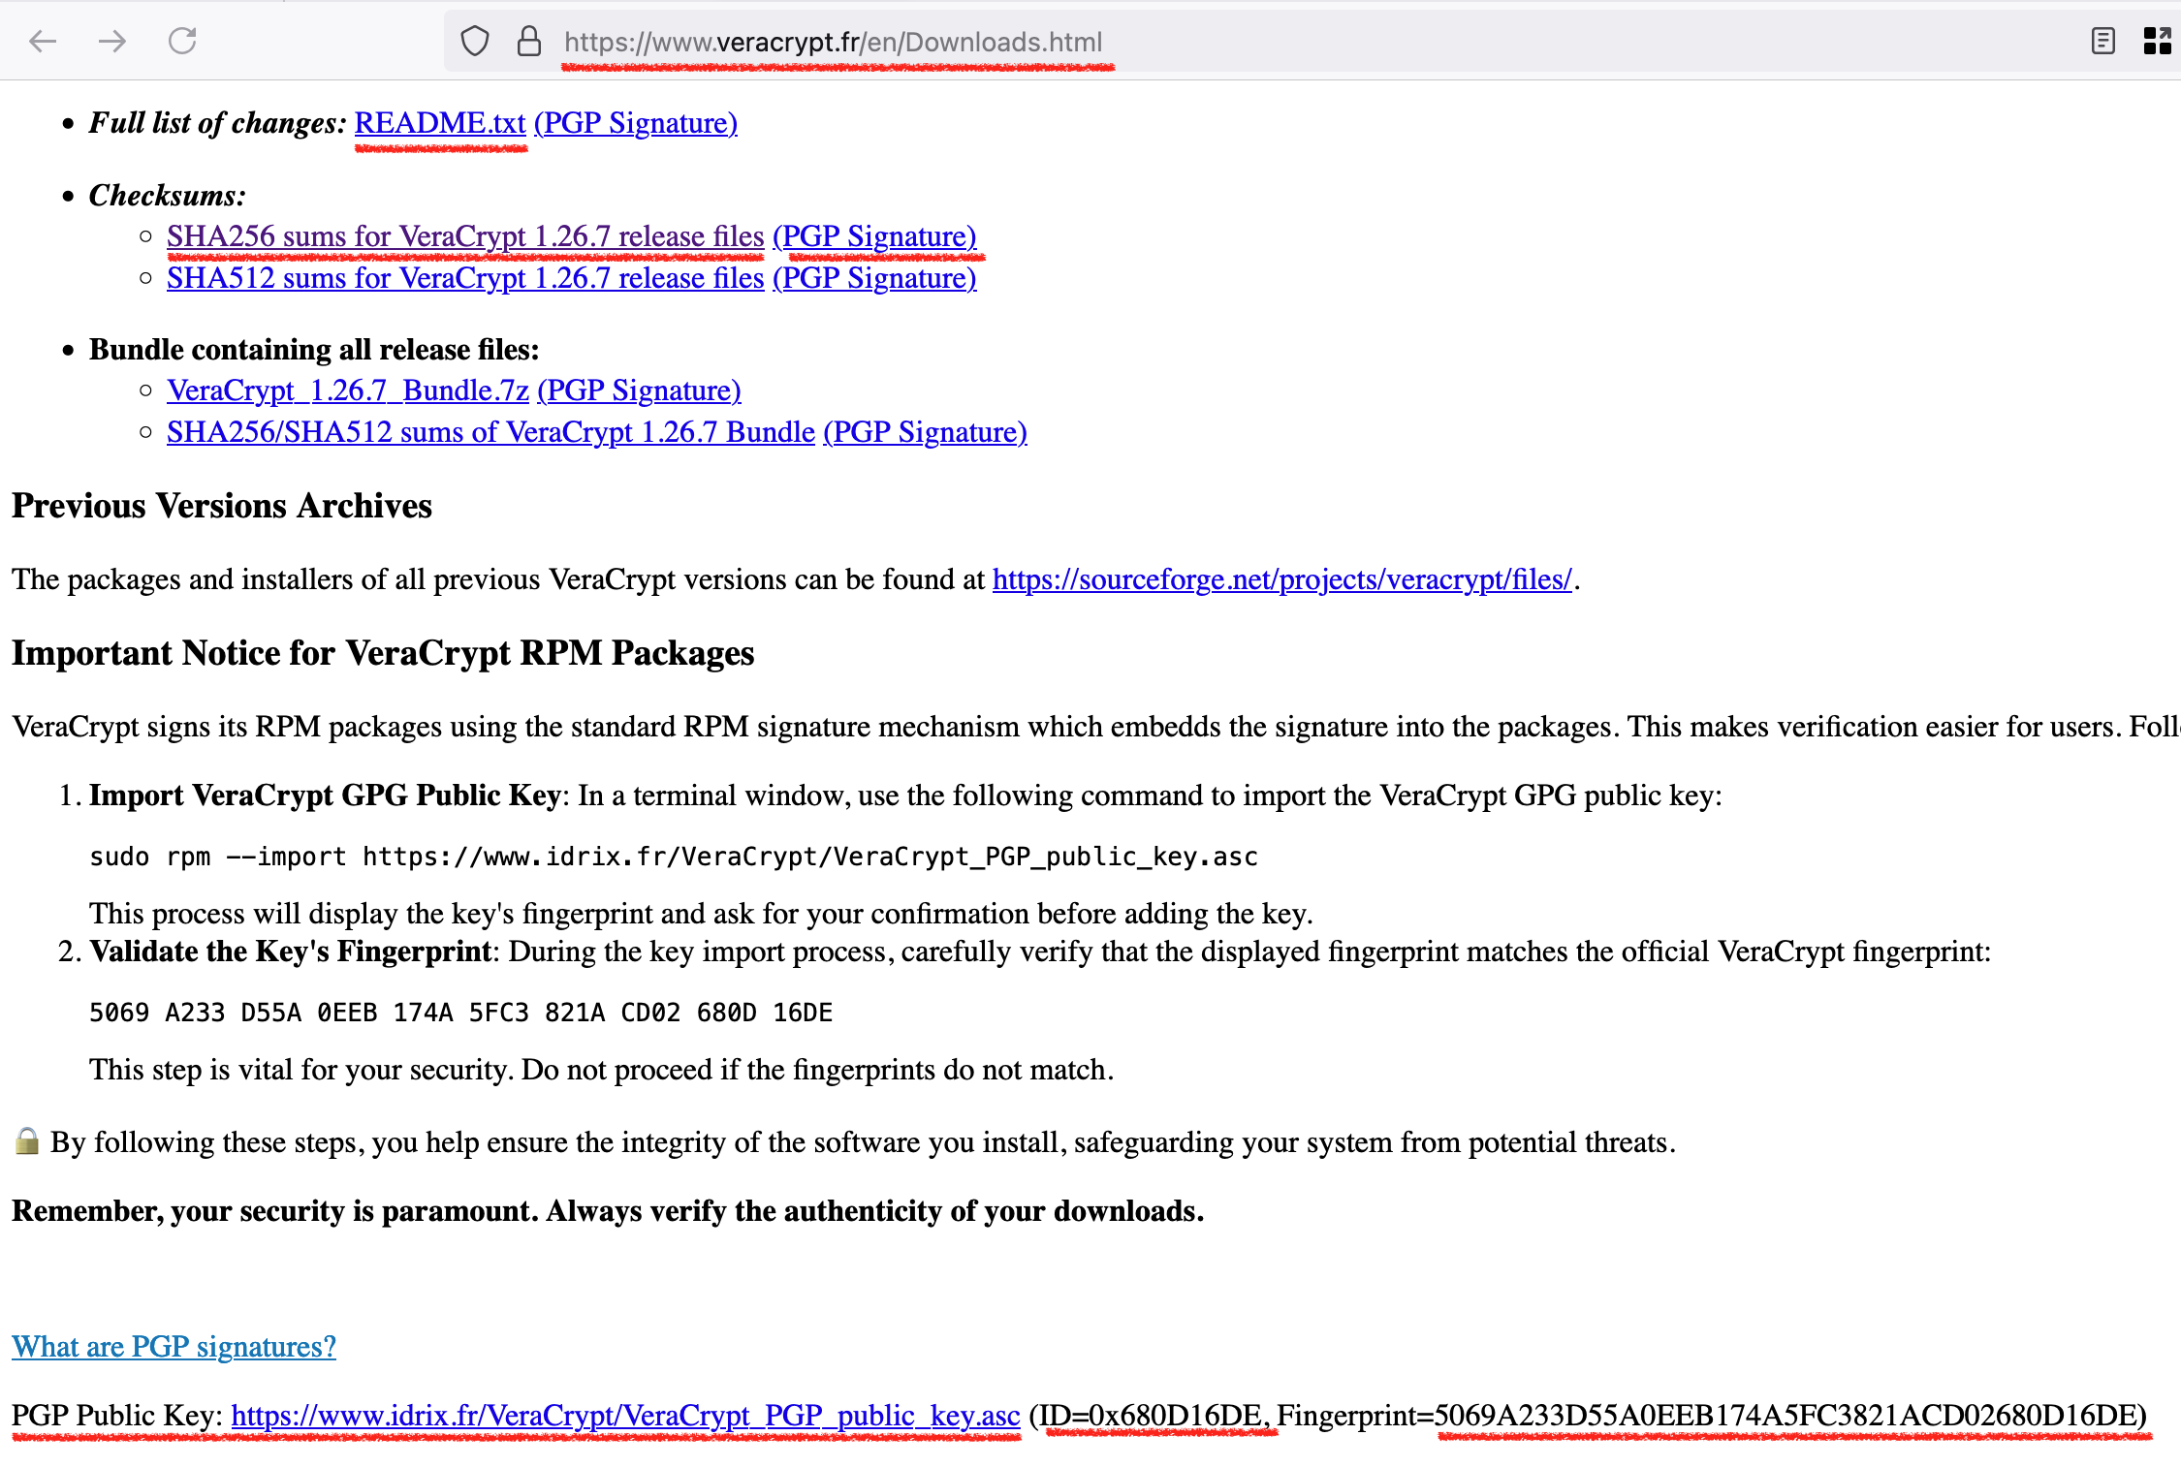
Verifying Files from the Internet, Veracrypt
Go to https://www.veracrypt.fr/en/Downloads.html
Download
README.TXT
README.TXT.sig
Notice PGP Keys
ID=0x680D16DE

Slide 43
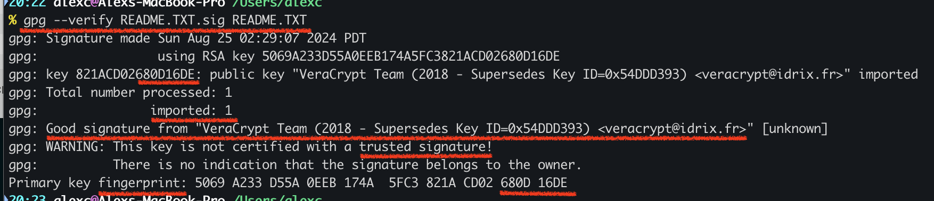
Verifying Files from the Internet, Veracrypt (Continue)
gpg --verify README.TXT.sig README.TXT
You can --import Key and trust this Key to avoid WARNING

Slide 44

Encrypt / Decrypt Files
gpg -e -s -a -u pgpworkshop777@gmail.com -r achesnakov777@gmail.com message.txt
gpg -d message.txt.asc
-e, --encrypt
-s, --sign
-a, --armor
-d, --decrypt
-u, --local-user USER-ID
use USER-ID to sign, encr, decr
-r, --recipient USER-ID
encrypt for USER-ID
Note: You can add multiple
recipients, including yourself
to be able to decrypt the message

Slide 45


Proton Mail and mobile clients
Proton Mail is OpenPGP compatible and works with non-Proton email
Proton Mail is handling encryption
You will not be able to use Thunderbird
Proton Mail Bridge is a way to use std. email client, but it handles encryption
Proton Mail clients are available for macOS, Windows, Linux, iOS, Android
Thunderbird Mobile for Android

Slide 46
Not Covered
Web of Trust
Traditional OpenPGP keyservers
Key Signing Parties
Photo IDs in OpenPGP keys
Sub-Keys
Edit Keys (gpg --edit-key)
Physical Keys: YubiKeys, Smartcards

Slide 47
Q&A
SSL/TLS and SSH use public / private keys as well. What the difference?

Slide 48
Resources:
https://emailselfdefense.fsf.org/en/
https://www.gnupg.org/gph/en/manual.html
https://www.oreilly.com/library/view/pgp-gpg/9781457185212/
Free O’REILLY access with San Jose Public Library
https://www.sjpl.org/resource/oreilly/

Slide 49



Thanks
https://github.com/olexandrch/OpenPGP_Email_Encryption_Workshop
https://www.linkedin.com/in/alex-chesnakov/

